Slide 1


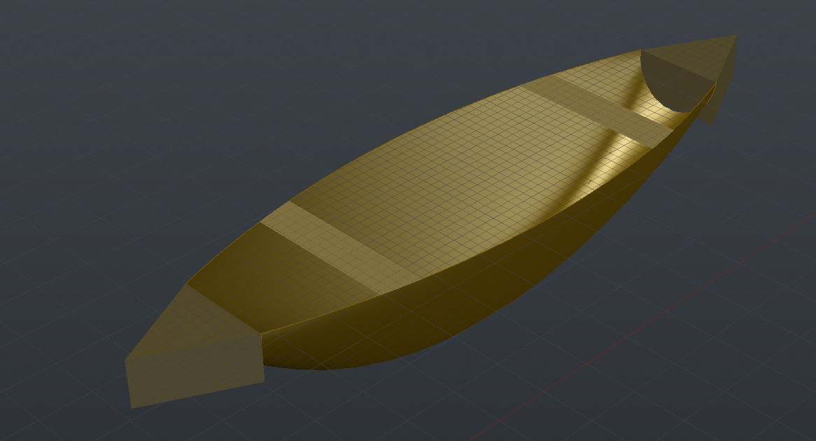
3D Wooden Boat
Department of CSE
Green University of Bangladesh Permanent Campus

Slide 2

Presented by
Jakiyatun Naima- 193902013
Mahbub Al Suprove Meshbah -193902016
Department of CSE Green University of Bangladesh Permanent Campus

Slide 3
Topics
Introduction
Overview
Required System
Design
Conclusion
3D Wooden Boat

Slide 4
Introduction
A wooden boat is a vessel constructed of wood generally intended to transport one or more persons across a body of water. And we tried to design a boat in 3D by using Autocad.
3D Wooden Boat

Slide 5
Project Overview
We aim to inspire and captivate with the beauty and functionality of our 3D wooden boat project.
3D Wooden Boat

Slide 6
Required System
Windows Operating System
AutoCAD
3D Wooden Boat

Slide 7
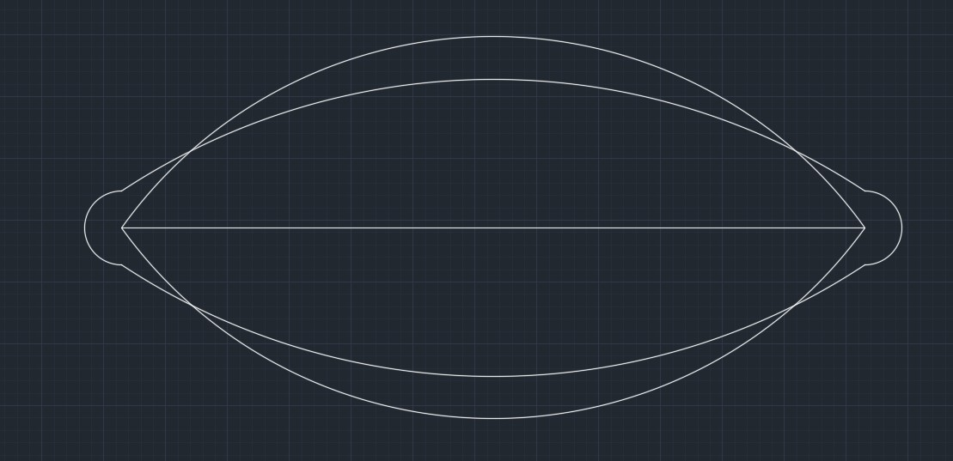
Design
Drew a line of 30 cm.
Drew 3 points arcs on both side of the line and connected the centers of the arcs.
Drew another arc on upper side and mirrored it.
Drew another 3 point arc from the center the arcs on boths sides and mirrored the arc.
3D Wooden Boat

Slide 8
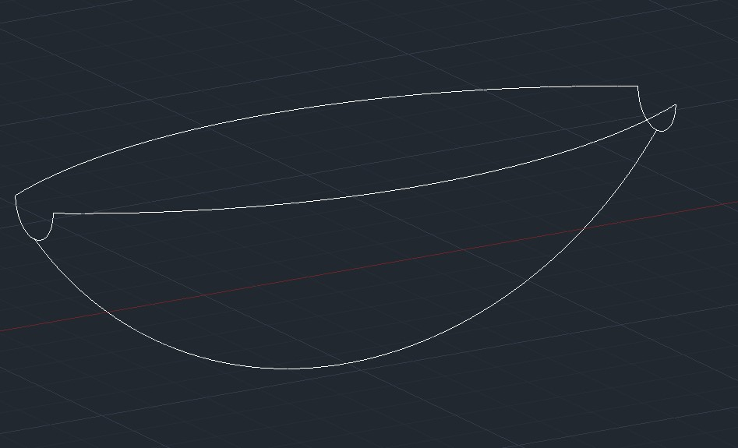
Design
Changed the view to SW Isometric and 3D rotated the middle arc by 270 degree.
3D rotated the arcs of both sides by 270 degrees.
3D Wooden Boat

Slide 9
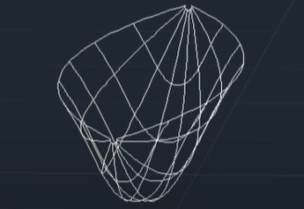
Design
Then selected the surface from network and created the surface by selecting the edges.
3D Wooden Boat

Slide 10
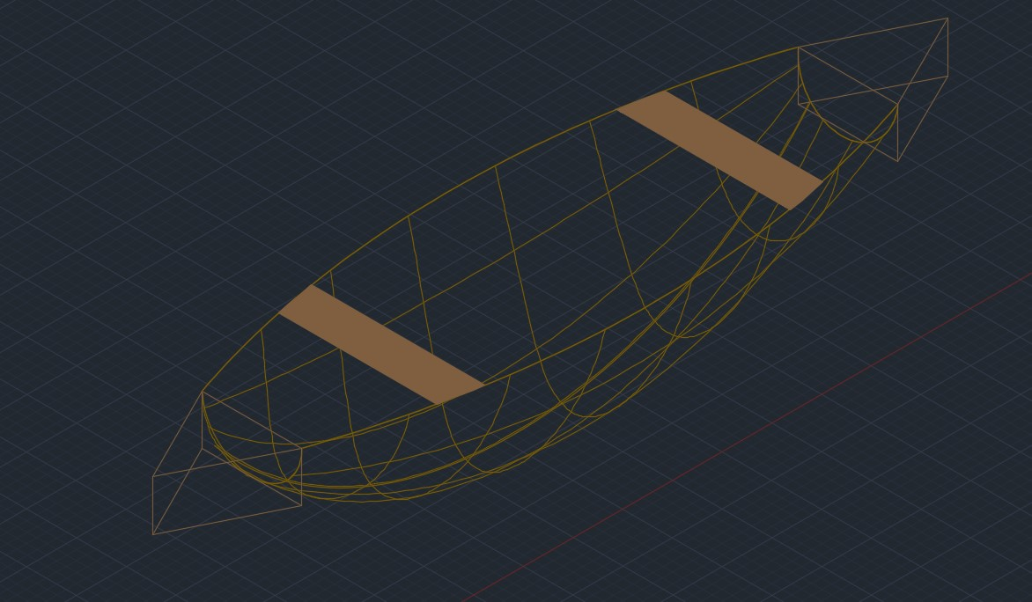
Design
Drew two triangles on boths sides and two decs and changed the color.
3D Wooden Boat

Slide 11
Design
Finally changed the view to SW Isometric and Realistic.
3D Wooden Boat

Slide 12
Conclusion
Our 3D wooden boat design represents a harmonious blend of aesthetics, functionality and craftsmanship.
3D Wooden Boat

Slide 13

3D Wooden Boat

Slide 14

3D Wooden Boat

